Slide 1
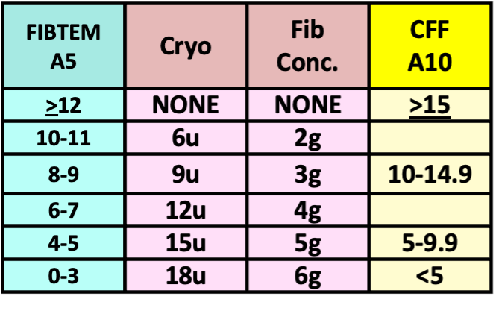
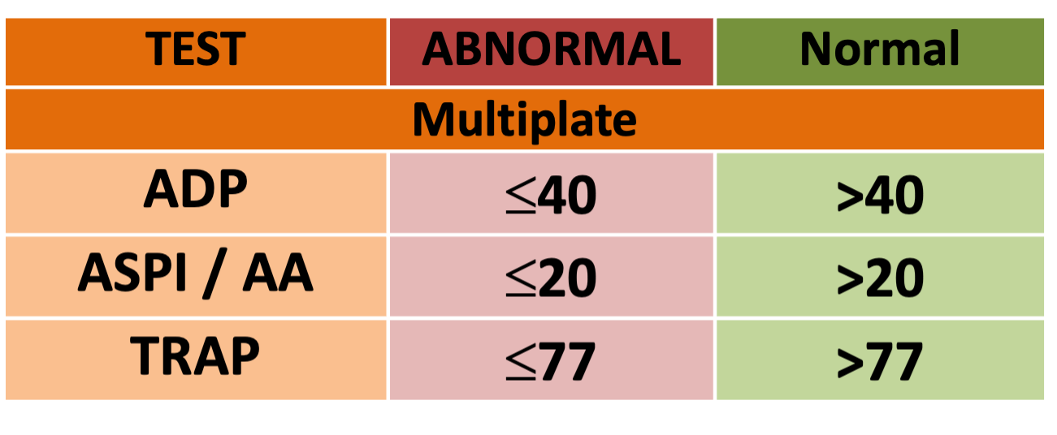
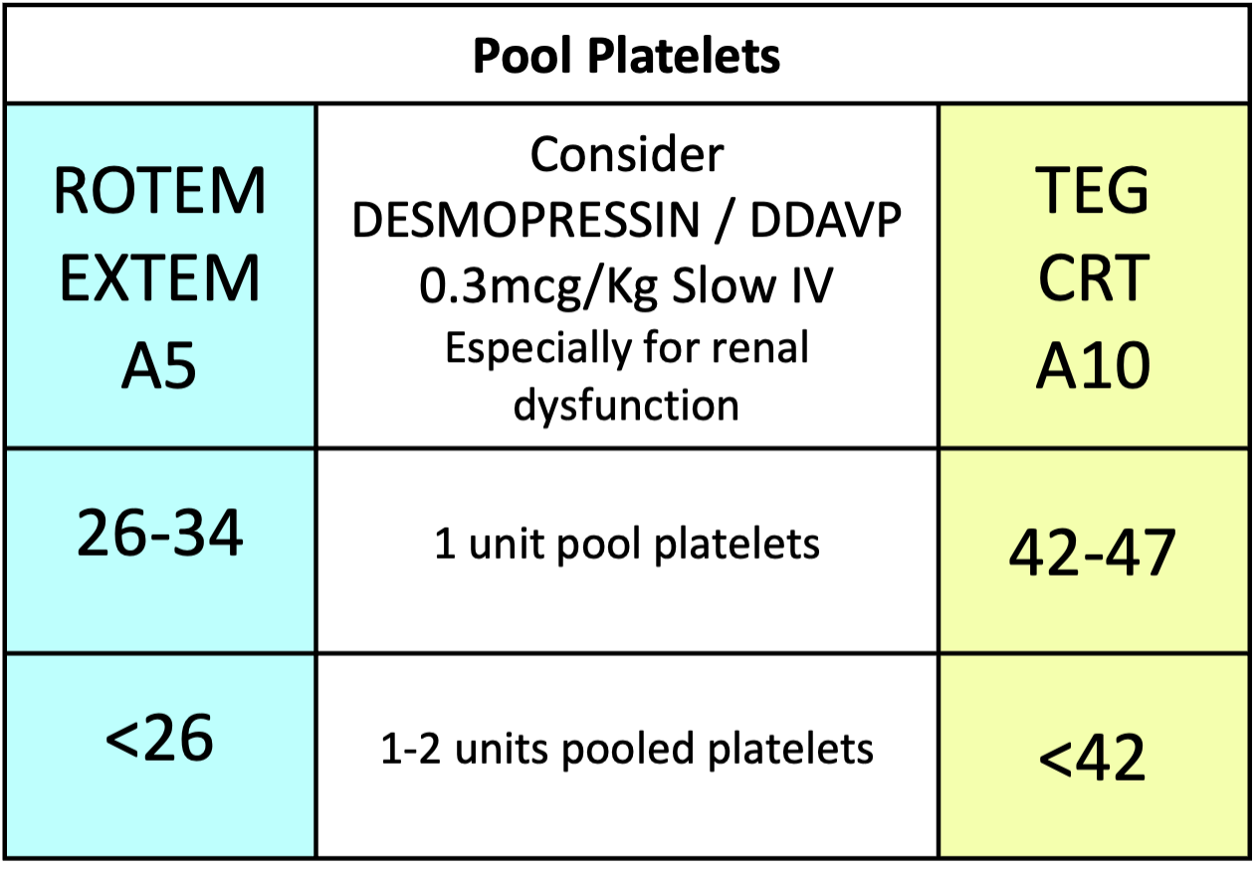
GENERAL SURGICAL / OBSTETRIC HAEMORRHAGE ROTEM & TEG GOAL DIRECTED BLEEDING MANAGEMENT ALGORITHM (2025)
Temp >36° C, pH >7.2, iCalcium >1.1 mmol/L, Platelets >70x10⁹/L, Hb >75 g/L
Adjust dose of blood products for patients <50kg after consulting senior clinician
Repeat test 10 mins
AFTER EACH INTERVENTION
IF BLEEDING CONTINUES
IS THERE CLINICALLY SIGNIFICANT BLEEDING?
YES
NO
ROTEM
Results in 10 min
Then
High risk of Fibrinolysis?
E.g. trauma, obstetric, major ortho Consider Tranexamic Acid 1g IV now
Observe
Tranexamic Acid
1 gram
Or 15mg/kg
Consider repeat dose if patient has lost over one blood volume since initial dose
Adjust subsequent dose for renal dysfunction
CLOT INSTABILITY Early diagnosis
EXTEM A5 <35mm | CRT A10 <47mm
Flat line FIBTEM or CRT at 5min
Hyperfibrinolysis
FIBRINOLYSIS
YES
PROCEED WITH ALGORITHM
Cryo or FibConc.
If FIBTEM A5< 6 or CFF A10 <10,
ensure platelets are also available
RETEST
NO
FIBRINOGEN
IS FIBTEM A5 < 12mm? (close correlation to Clauss fibrinogen) | Is CFF A10 < 15mm? (Local validation recommended)
Including flat line at 5 minutes
YES
Low Fibrinogen
Clinician discretion for Fibrinogen Concentrate
Usually for massive obstetric haemorrhage or severely low FIBTEM or CFF
NO
YES
Poor Platelet Contribution
NORMAL FIBTEM A5 ≥ 12mm AND IS EXTEM A5 < 35mm? | NORMAL CFF A10 > 15mm AND IS CRT A10 < 47mm?
Or abnormal Multiplate
RETEST
PLATELETS
NO
NORMAL FIBTEM A5 ≥ 12mm AND IS EXTEM CT > 85 sec? | NORMAL CFF A10 > 15mm? AND Is CKH-R > 10 minutes
Ensure core temp >36°C and Fibrinogen corrected first
YES
Low Coagulation Factors or Oral anticoagulants (Warfarin or DOACs)
ELP/ FFP 2-4 units
OR
Beriplex
(If volume overloaded)
10-15 Units/kg IV
RETEST
FACTORS
NO
CLOT INSTABILITY after 30 minutes
IS FIBTEM ML ≥ 10 %? | Is CRT (LY30) > 2.2%
Clot should be stable for 1 hour, not tapering away
YES
Hyperfibrinolysis
Consider additional tranexamic acid
Consider APTEM if available to further investigate clot instability
E.g. Factor XIII, clot retraction
FIBRINOLYSIS
NO
STILL BLEEDING? Consider SURGICAL PROBLEM and discuss with surgeon and blood bank/haematologist
Make a stronger clot? Give Cryo to FIBTEM A5 > 14mm Give platelets to EXTEM A5 > 40 mm or consider Platelet Function testing (in hours) Consider ELP to shorten clotting time to EXTEM CT < 80 sec | Re check temperature, pH, iCalcium, platelets and haemoglobin Consider other contributors to bleeding Platelet inhibitors (do Multiplate Platelet Function test) Consider Von Willebrand's Disease, warfarin (INR), enoxaparin etc.
NORMAL
When clinically possible always complete the algorithm in a stepwise manner and check the ROTEM between steps as indicated. This reduces unnecessary transfusion, especially of Platelets, ELP and Beriplex

